Slide 1

Behavior Driven Development
www.pragmatic.bg
Lector: Dimitar Topuzov
E-mail: dtopuzov@gmail.com
LinkedIn: http://bg.linkedin.com/pub/dimitar-topuzov/18/470/833/en
Copyright © Pragmatic LLC 2018

Slide 2
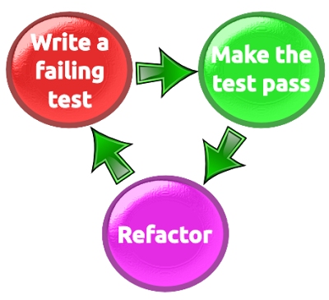
Let’s Talk About Development Practices
Test Driven Development

Slide 3
Something Went Wrong
Test Driven Development On Practice
Usually TDD = Unit tests written from developer for his/her own code
Usually result in “confirmation that the system does what it does”

Slide 4

Bike Example
Let’s write some tests that test a bike
Verify pedals are available
Verify breaks are available
Verify seat is available
Verify bike has two tires

Slide 5
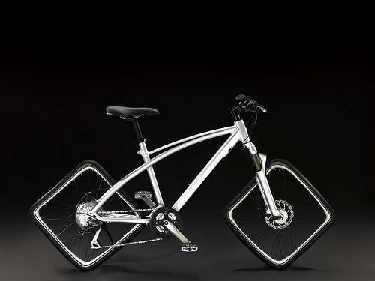
Bike Example
Is it a Bike?
Pedals
Breaks
Seat
Two Tires

Slide 6
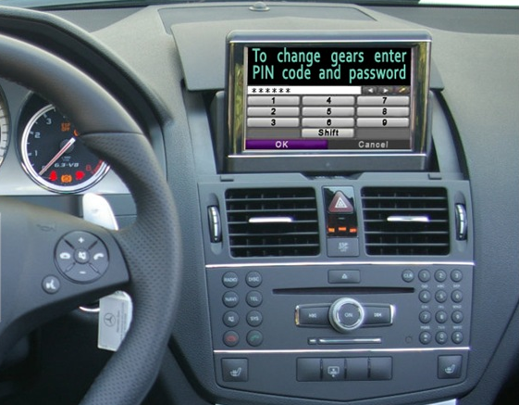
Useless Car Example

Slide 7

The Problem
What happened?
ITs are not Domain Experts
Domain Experts don’t know the technology

Slide 8
The Solution
How to solve the problem?
Make sure Acceptance Criteria is defined by Domain Experts
Make sure Domain Experts and ITs talk the same language
Make sure you have Single Source of Truth
Illustrate requirements using examples
Automate those examples

Slide 9

Behavior Specifications
Title (one line describing the story)
Narrative:
As a [role]
I want [feature]
So that [benefit]
Acceptance Criteria: (presented as Scenarios)
Scenario 1: Title
Given [context]
And [some more context]...
When [event]
Then [outcome]
And [another outcome]...
Scenario 2: ...

Slide 10
Scenario Example
Scenario: Divide by zero
Given clean calculator
When press 1
And press divide button
And press 0
And press equal button
Then the result should be
Cannot divide by zero

Slide 11
Bad Scenario Example
Scenario: Divide by zero
Given calculator.exe is started
When click button with id=Btn1
And click button with id=BtnDevide
And click button with id=Btn1
And click button with id=BtnEqual
Then text box with name=Result contains Cannot divide by zero text

Slide 12
How to Write Scenarios
Don't specify business rules...
...but key business examples
Customer can easily read and understand them
Features should only contain information that the user sees
Step description should never contain regexes, CSS or XPath selectors, any kind of code or data structure

Slide 13
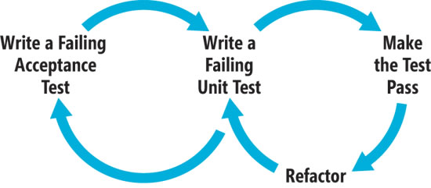
Behavior Driven Development
Based on TDD
Focusses on behavior of the product

Slide 14
BDD Tools
BDD Tool | Specifications Format | Implements Gherkin | Platforms
Specflow | Plain text | Yes | .NET
Cucumber | Plain text | Yes | Ruby
Cucumber-JVM | Plain text | Yes | Java and JVM languages
Jbehave | Plain text | Yes | Java
Rspec | BDD like API | No | Ruby
Concordion | Html | No | Java, .NET, Python, Scala, Ruby

Slide 15
To BDD or NOT to BDD
To BDD or NOT to BDD
…it is a topic for a beer discussion
Note that using BDD tools != Follow BDD as Process
Sometimes we might use only the tools just because they give us some benefits

Slide 16
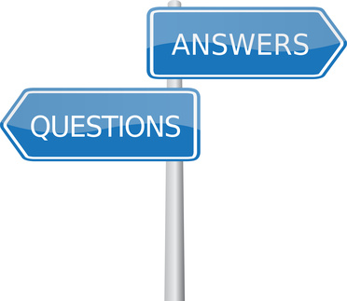
Questions

